Slide 1


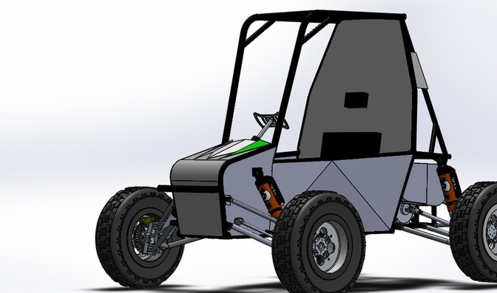
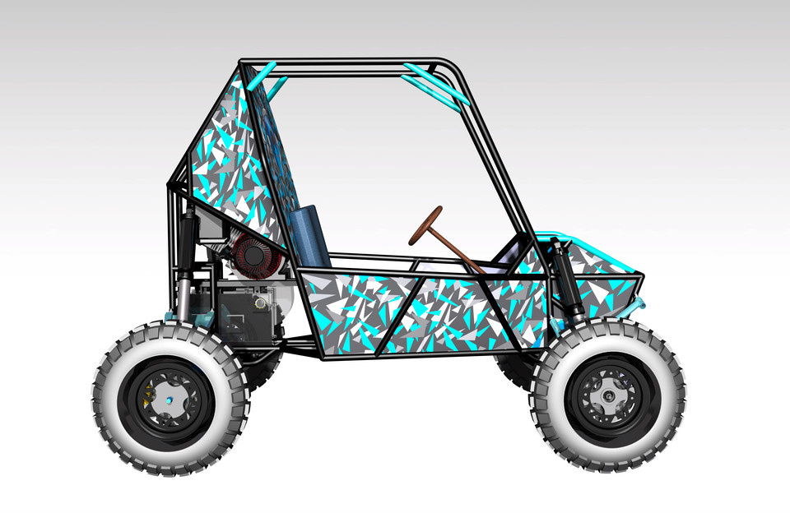

Electrical (BMS) department

Slide 3
Table Of Contents
1
To understand the rule book properly
Some basic terms
2
main electrical components
Rules and regulations about electrical components
3
Circuit diagram
Try to arrange the electrical components according to the rule book.

Slide 4
  High Voltage (HV)
  Tractive System
  Tractive System Voltage
  Tractive System Accumulator
  Tractive System Accumulator Container
  HV Rated Cut-Off Switch
  Accumulator Isolation Relay (AIR)
  Low Voltage (LV)
  Ignition/Master Switch
  Kill Switch
  Tractive System Active Light (TSAL)
1
Some basic terms

Slide 5


1 .HIGH VOLTAGE (HV):
In automotive engineering, “High Voltage” is defined as voltage greater than 30 VAC root mean square (RMS) or 60 VDC.
2 .TRACTIVE SYSTEM:
The tractive system of the vehicle is defined as complete electrical system of every part that is electrically connected to the motor(s) and tractive system Accumulator(s).
3 .TRACTIVE SYSTEM VOLTAGE:
The Voltage between any two terminals of the tractive system. The tractive system voltage shall not exceed 60V DC in any condition.
4 .TRACTIVE SYSTEM ACCUMULATOR:
The tractive system Accumulator(s) is defined as complete assembly / pack of all the battery cells that store the electrical energy to be used by the tractive system along with the corresponding contactor, fuse, and battery management systems/solutions.

Slide 6
5 .TRACTIVE SYSTEM ACCUMULATOR CONTAINER:
It is an enclosure/housing for the Tractive System Accumulator.
6. HV RATED CUT-OFF SWITCH:
The HV rated cut-off switch shall operate on Tractive system voltage. When turned off, the Tractive System Accumulator shall not power the DC-DC Converter. The HV rated cut-off switch must be mounted behind the firewall.
7. ACCUMULATOR ISOLATION RELAY (AIR):
The Accumulator isolation relay should isolate the Accumulator from the tractive system.
8 .LOW VOLTAGE:
The low voltage (LV) system of the vehicle is defined as complete electrical system of every part that is not part of the tractive system. The Voltage between any two terminals of the Low Voltage system in the vehicle shall not exceed 15V DC in any condition.

Slide 7

9. IGNITION/MASTER SWITCH:
The Ignition switch shall operate on <=15V DC. When turned off, the LV Power source should not power any LV components.
10. KILL SWITCH:
The Kill switch shall operate on <=15V DC. Kill switch must de-energize the Tractive system, AIR, and TSAL, may de-energize the reverse light, and reverse alarm but shall not de-energize the Brake Light when brake pedal is pressed.
11 .TRACTIVE SYSTEM ACTIVE LIGHT (TSAL):
The TSAL shall operate on Low Voltage. TSAL should be continuously flashing/blinking with a frequency of 2Hz to 5Hz when the tractive system is active.

Slide 8

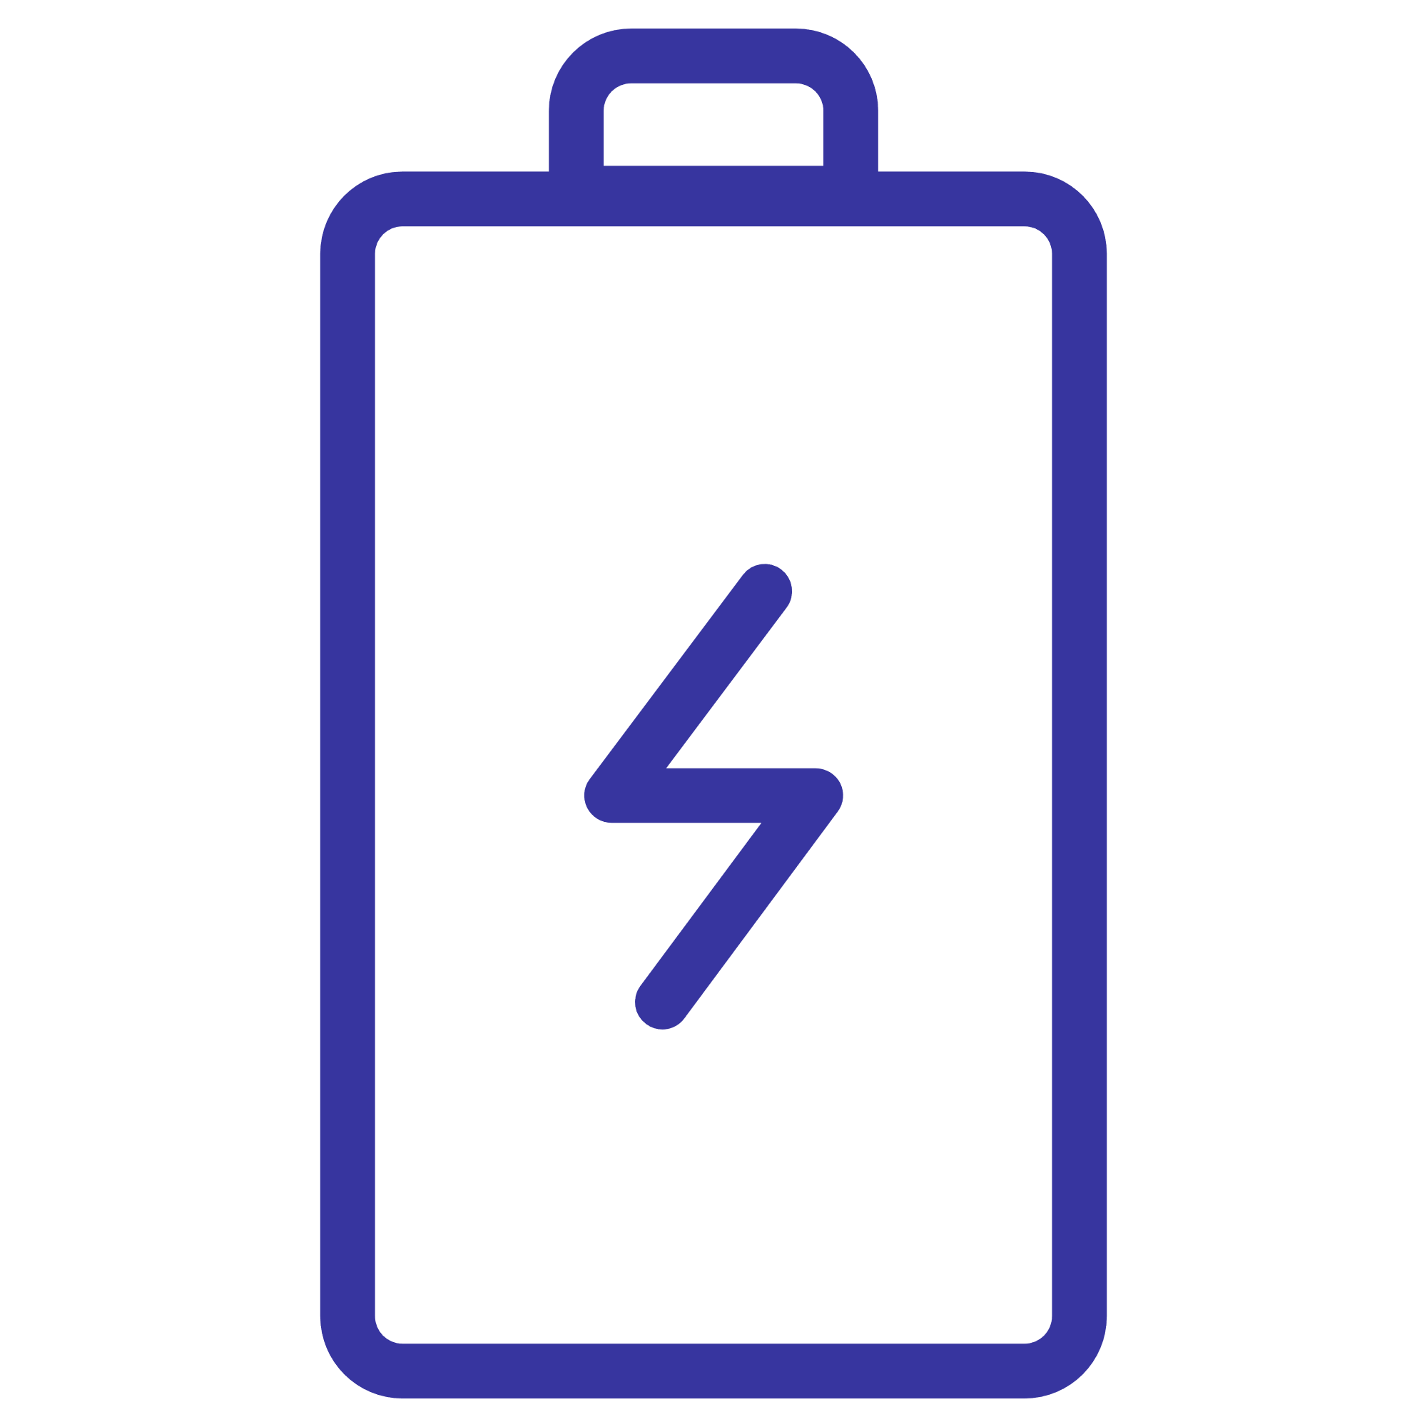


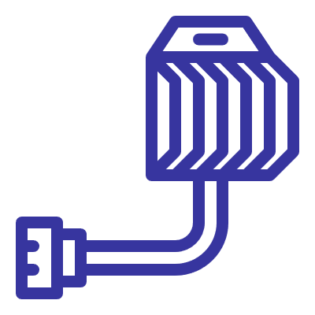

2
main electrical components

Slide 9


Power and Voltage Limitations
Voltage Limit
1
Maximum 60V in the tractive system; violation leads to disqualification.
2
Power Limit
Maximum 9kW, measured at the battery terminals or MCU; violation leads to disqualification.
Fuse Enforcement
3
EV-grade instant fuse/DC MCB with appropriate voltage and current rating.
Strict power and voltage limitations are enforced to ensure safety and fair competition. The maximum voltage in the tractive system must not exceed 60V, and the maximum power must not exceed 9kW at any instant. Power limits are enforced using an EV-grade instant fuse/DC MCB with a DC voltage rating greater than or equal to the tractive system voltage. Violating these limits will result in disqualification, emphasizing the importance of careful monitoring and compliance. Teams must make sure their electrical systems are not overloaded.

Slide 10




Motor :
  any type of motor can used.
  peak voltage: 60 v DC.
  peak power: 9kw
  weight as low as possible
  all electrical components must follow IP67 standards.
  we can use BLDC/PMSM motor
Fuse
  Voltage – Matches system voltage.
  Current – Rated for load demand.
  Breaking Capacity – Handles fault currents.
  Type – Fast
  Form –HV fuse.
Relay
  Coil Voltage – 12V as required.
  Contact Rating – Matches load specs.
  Switch Type – NO/OFF as per circuit.
  Capacity – Max switching power.
  Insulation – High dielectric strength.

Slide 11


TRACTIVE SYSTEM ACCUMULATOR:
  capacity:120 Ah.
  peak voltage: 60 v DC.
  all electrical components must follow IP67 standards.
  Battery must be of Lithium ion chemistry.
BMS Protection Features
  Overvoltage & Undervoltage Protection
  Overcurrent Protection
  Thermal Protection
  Short Circuit Protection
  Isolation Fault Detection

Slide 12
DC-DC Converter
  Converts HV to LV DC.
  Ensures HV-LV electrical isolation.
  Matches LV load requirements.
  Requires efficient thermal management.
  Secure, vibration-resistant mounting.
Auxiliary Battery
  Provides LV power backup.
  Must be sealed, maintenance-free.
  Requires proper voltage regulation.
  Needs isolation and fault protection.
  Secure, vibration-resistant enclosure.
  Sized for auxiliary power demands

Slide 13
General Requirements
1) The below tests are mandatory to be performed on the Accumulators for eBAJA if AIS 156 compliance authentic Certification is unavailable:
i) Physical verification of battery pack including BMS safety features.
ii) Vibration test.
iii) Overcharge protection.
iv) Over Temperature Protection.
2) The Tractive System shall include at least one AIR and one Fuse, which will open the circuit and disconnect the energy flow from Accumulator(s) to the remaining tractive system whenever a fault is detected.
3) driver display must have the following:
1)State of Charge (SOC) Indicator 4) Vehicle Speed and Power Output
2)Battery Voltage and Current Display 5)Temperature Monitoring
3)Error and Fault Warnings

Slide 14
3
Circuit diagram

Slide 15
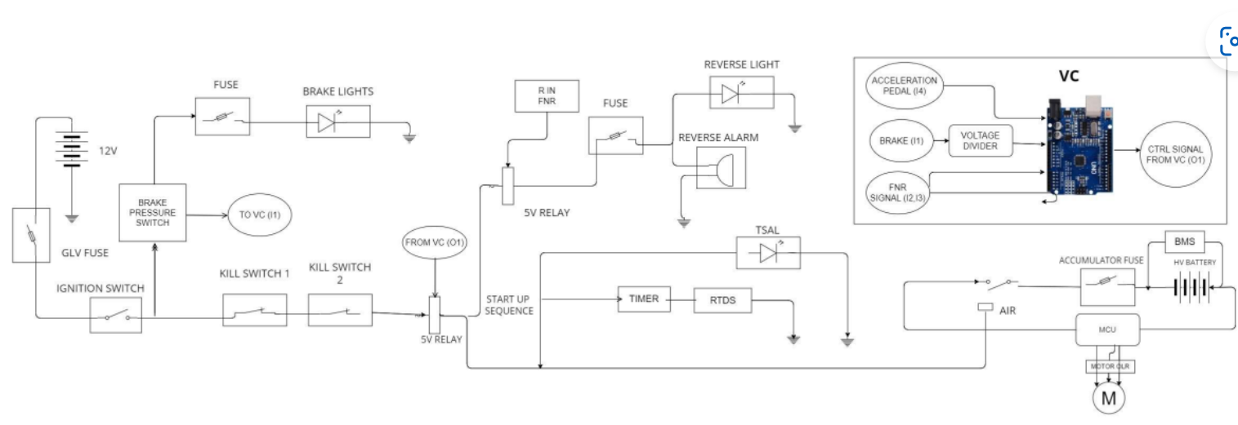
Sample Circuit Diagram

Slide 16
THANK YOU

